Slide 1
Week 2 Report
CHEM4966 Chemistry Internship Capstone
Eunah Jung (3035446071)

Slide 2
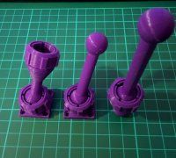
Question: Will stronger magnets solve the current situation?
Use stronger magnets. Stronger magnets repel when 4 magnets were placed in the ball (atom) model. However, I can look for stronger glues.
Print new 3D components. We can still use the same magnets. Smaller balls and thinner bonds will allow the current magnets to bond tighter and so the entire model should be more stabilized to form the chair and boat configurations.
Week 2 Plan
Market research on Ball and Socket models used in Organic Chemistry classes.
Research on alternative ways to connect ball (atom) and socket (bond).

Slide 3
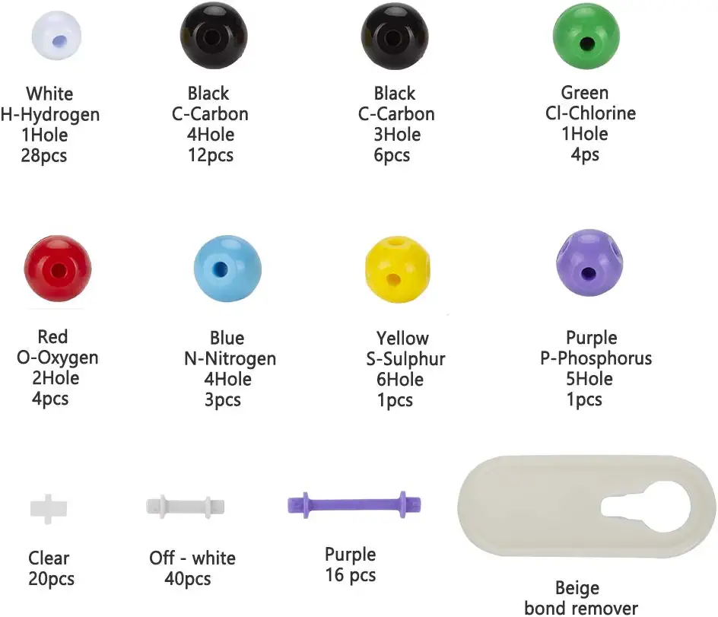
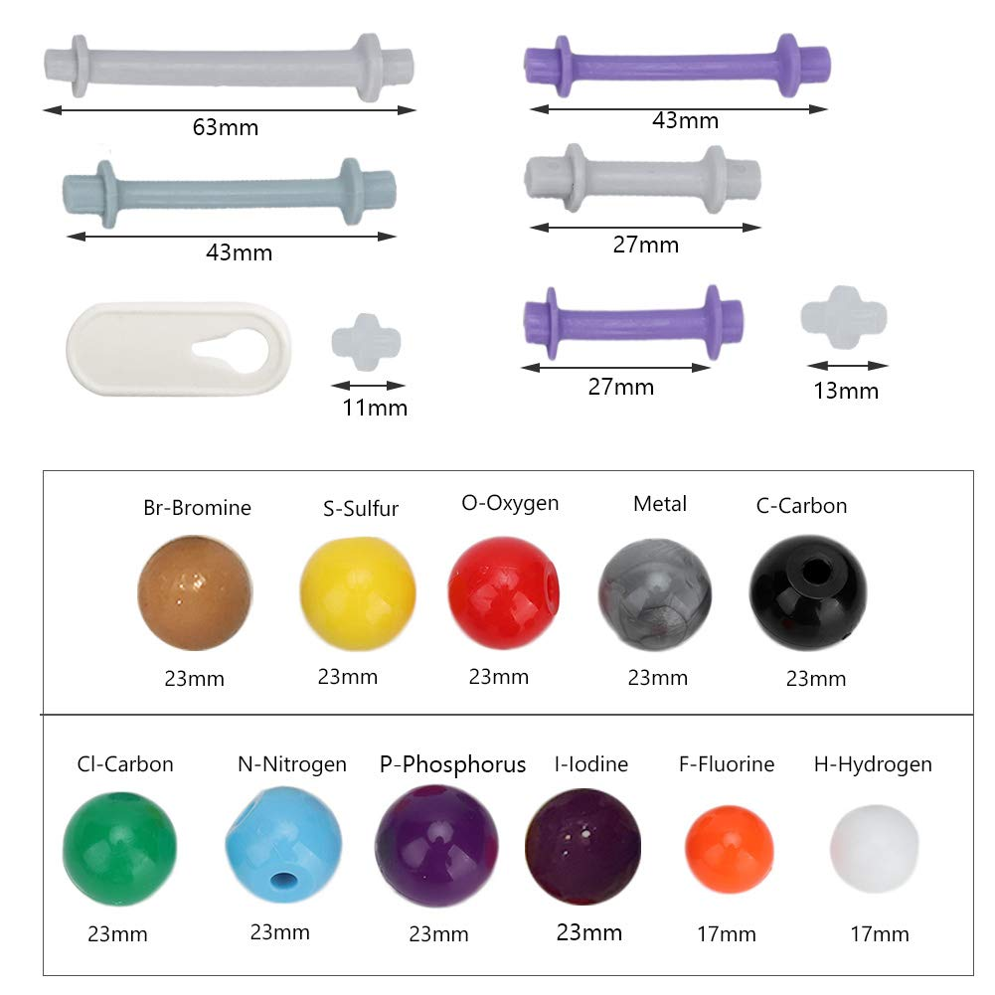
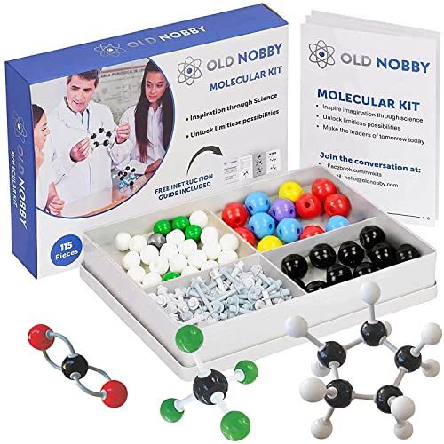
Notes:
Old nobby

